Slide 1
Introduction to Computation
Fan Cheng Shanghai Jiao Tong University
http://www.cs.sjtu.edu.cn/~chengfan/
chengfan@sjtu.edu.cn
Autumn, 2022
Notes:
Numbers, floating numbers, string, mathematical expressions, print()

Slide 2
Outline
Recursion
Problems

Slide 3

Stack (栈) diagram
Suppose we have a collection of books. When we pile them on a desk, we will first put a book on surface of the desktop and put the second one on the top of the first one, and so on. This process is called push
When we want to pick up the first book, we need to move the books from the last one to the second one. This process is called pop
The whole process can be modeled by stack.
FIFO: First in last out (push→pop)

Slide 4
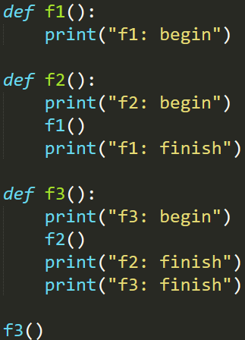
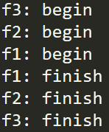
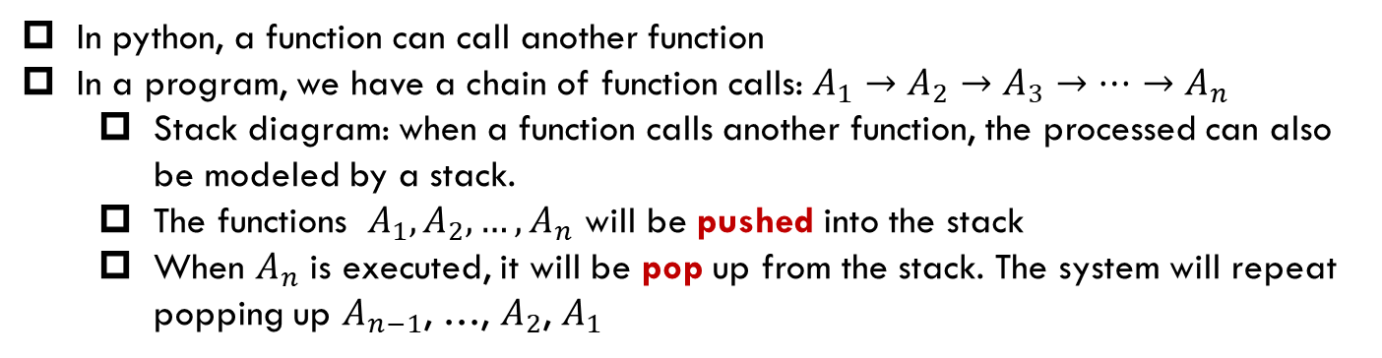
Function calls
调用顺序
返回顺序
In python, a function can call another function
In a program, we have a chain of function calls: $A_{1}→A_{2}→A_{3}→…→A_{n}$
Stack diagram: when a function calls another function, the processed can also be modeled by a stack.
The functions $A_{1},A_{2},…, A_{n}$ will be pushed into the stack
When $A_{n}$ is executed, it will be pop up from the stack. The system will repeat popping up $A_{n−1}$, …, $A_{2}$, $A_{1}$

Slide 5
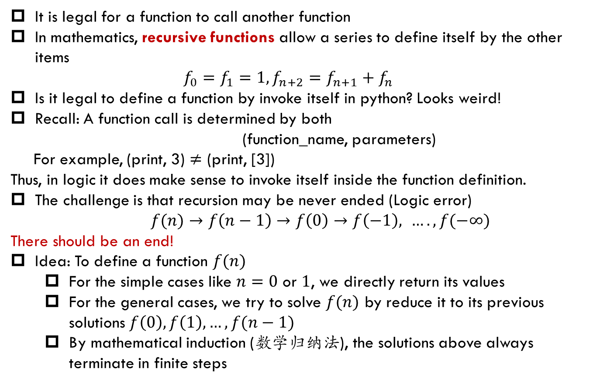
Recursion (递归)
It is legal for a function to call another function
In mathematics, recursive functions allow a series to define itself by the other items
$$f_{0}=f_{1}=1, f_{n+2}=f_{n+1}+f_{n}$$
Is it legal to define a function by invoke itself in python? Looks weird!
Recall: A function call is determined by both
(function_name, parameters)
For example, (print, 3) $≠$ (print, [3])
Thus, in logic it does make sense to invoke itself inside the function definition.
The challenge is that recursion may be never ended (Logic error) $f(n)→f\left(n−1\right)→f\left(0\right)→f\left(−1\right), …., f(−∞)$
There should be an end!
Idea: To define a function $f(n)$
For the simple cases like $n=0$ or $1$, we directly return its values
For the general cases, we try to solve $f(n)$ by reduce it to its previous solutions $f\left(0\right), f\left(1\right), …, f(n−1)$
By mathematical induction (数学归纳法), the solutions above always terminate in finite steps

Slide 6
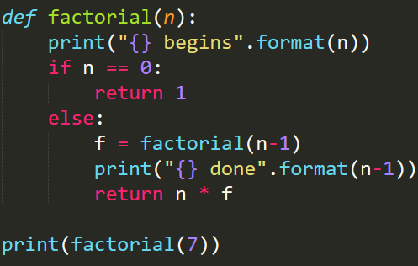
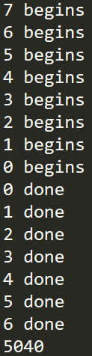
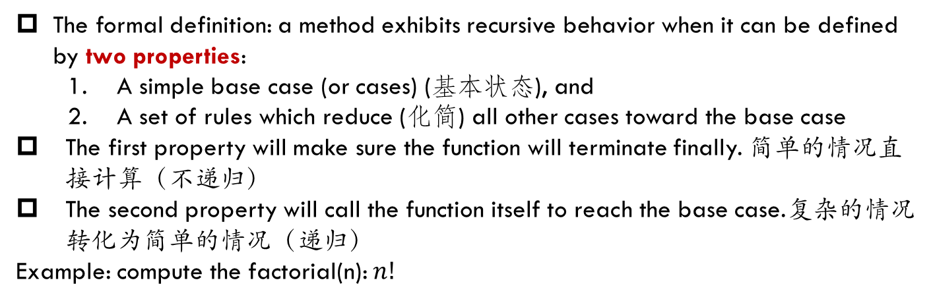
Recursive function
The formal definition: a method exhibits recursive behavior when it can be defined by two properties:
A simple base case (or cases) (基本状态), and
A set of rules which reduce (化简) all other cases toward the base case
The first property will make sure the function will terminate finally. 简单的情况直接计算（不递归）
The second property will call the function itself to reach the base case.复杂的情况转化为简单的情况（递归）
Example: compute the factorial(n): $n!$

Slide 7
N=0
1

Slide 8
调用顺序
N=1
N=0
1
1
执行顺序

Slide 9
调用顺序
N=2
N=1
1
1
N=0
执行顺序

Slide 10

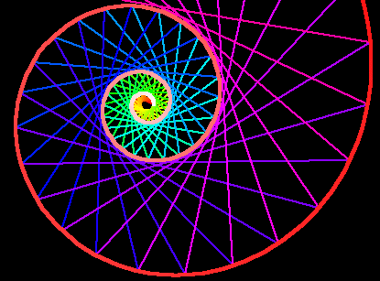
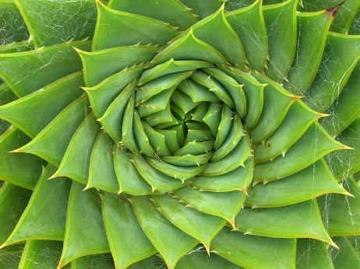
Recursion (递归)
When problems have an inherited similar structures, you may consider recursion
递归函数的特点
问题具有递归的结构，可以状态转移(从一个函数值到另一个)
初始状态容易处理
递归函数编写的注意事项, 必须严格按照以下步骤
首先判断是否达到基本状态
再决定是否用递归关系处理
否则，会陷入死循环
一个函数调用由 函数名+具体的参数值 决定：f(1)和f(2)是不同的函数调用
递归调用：表面上是自己调用自己，实际上参数不同，是不同的函数调用

Slide 11
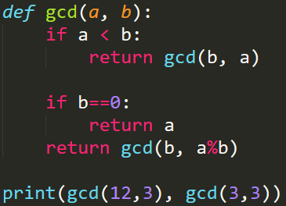
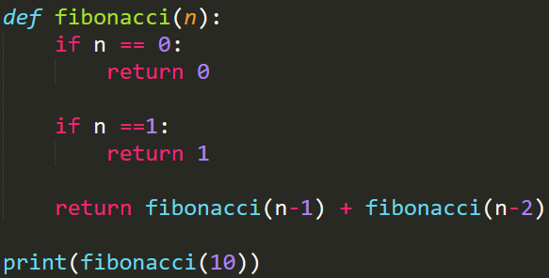

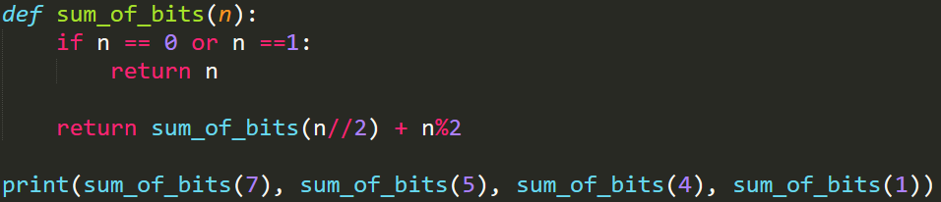

Recursive Function：Examples
A simple base case (or cases) (基本状态), and
A set of rules which reduce (化简) all other cases toward the base case
最大公约数
Fibonacci数列
整数的二进制和

Slide 12
gcd(a, b)
0 (b=0)
loga步结束

Slide 13
调用顺序
gcd(a, b)
gcd(b, a%b)
执行顺序
由于a>b, a%b$≤$b-1<b, 所以有限步后，不然后b=0

Slide 14
N=0
0
N=1
1

Slide 15
调用顺序
N=2
N=1
1
N=0
0
执行顺序

Slide 16

调用顺序
N=3
N=2
N=1
N=1
1
N=0
1
1
执行顺序
$2^{n}$步结束

Slide 17

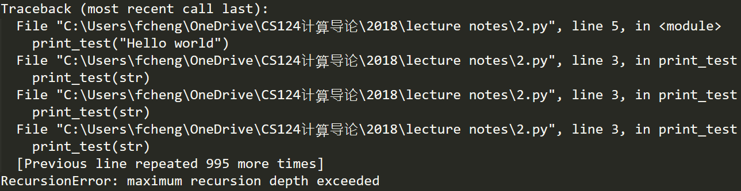
Infinite recursive function
Recursive functions without base case will lead to errors
RecursionError: maximum recursion depth exceeded

Slide 18
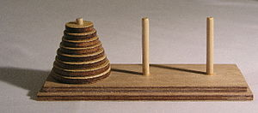
Hanoi
The Tower of Hanoi (汉诺塔) is a mathematical game or puzzle.
It consists of three rods and a number of disks of different sizes, which can slide onto any rod.
The puzzle starts with the disks in a neat stack in ascending order of size on one rod, the smallest at the top, thus making a conical shape.
The objective of the puzzle is to move the entire stack to another rod, obeying the following simple rules:
Only one disk can be moved at a time.
Each move consists of taking the upper disk from one of the stacks and placing it on top of another stack or on an empty rod.
No disk may be placed on top of a smaller disk
Give a solution to this problem.
假定，任务是从圆柱1，将圆盘经过圆柱2，全部移动到圆柱3。输出移动的过程。

Slide 19
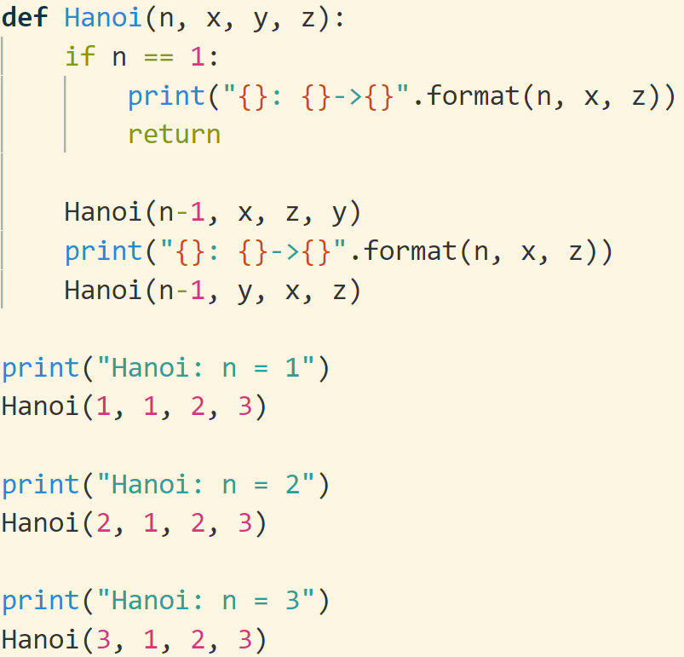
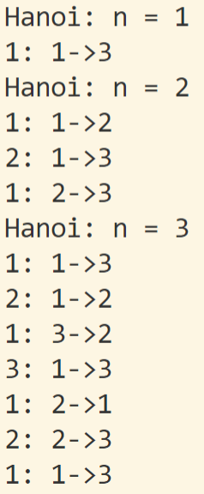
回顾：函数可以递归定义。但是函数调用时，即使函数名相同，参数不同也可以认为是不同的函数调用。
为方便理解，Hanoi(n-1, x, z, y)可以等价看成函数f(n-1) ； Hanoi(n-1, y, x, z)可以等价看成函数g(n-1)

Slide 20
N=1
print

Slide 21
N=2
N=1
N=1
print
print
print

Slide 22
调用顺序
执行顺序
N=3
N=2
N=1
N=1
N=2
N=1
print
print
print
N=1
print
print
print
print

Slide 23
递归函数
函数：一段具有某种功能的代码。
函数执行结束，表示着已经完成了函数所定义的功能。
递归函数：
1. 自己调用自己 ：从一个参数状态到另一个参数状态的转移 (状态转移)
2. 初始状态结束递归 (保证不会死循环)
3. 一个函数调用由 函数名+参数 决定，参数不同、函数名相同也是不同的调用
功能可以是：
函数值，譬如gcd (简单，好理解)
抽象的一组事件。譬如Hanoi (抽象，要仔细分析)
有问题？？？从定义出发思考
函数：一段具有某种功能的代码。函数执行结束，表示着已经完成了函数所定义的功能。

Slide 24
以函数Hanoi(n, x, y, z)为例：
定义功能：输出将n个盘子从x途经y搬到z的过程 (学习体会！)
由于Hanoi中每个小盘子只能放到大盘子上
首先要把盘子n，从x搬到z。必须先将1-(n-1)号盘子先搬到中间点y。
Hanoi(n-1, x, z, y) # 调用函数 n-1, x, z, y。函数结束运行后，表明已经完成了定义的功能（即输出了所有的步骤！细细体会！！）
然后将n号盘子从x搬到z。
最后一步，我们需要将1-(n-1)号盘子从y搬到z，递归调用即可
Hanoi(n-1, y, x, z)#调用函数 n-1, x, z, y。函数结束运行后，表明已经完成了定义的功能（即输出了所有的步骤！细细体会！！）
def Hanoi(n, x, y, z):
if n == 1: # 确保函数会结束递归
print("{}: {}->{}".format(n, x, z))
return
#下面三个函数调用完整地实现了Hanoi既定的功能
Hanoi(n-1, x, z, y)
print("{}: {}->{}".format(n, x, z))
Hanoi(n-1, y, x, z)

Slide 25
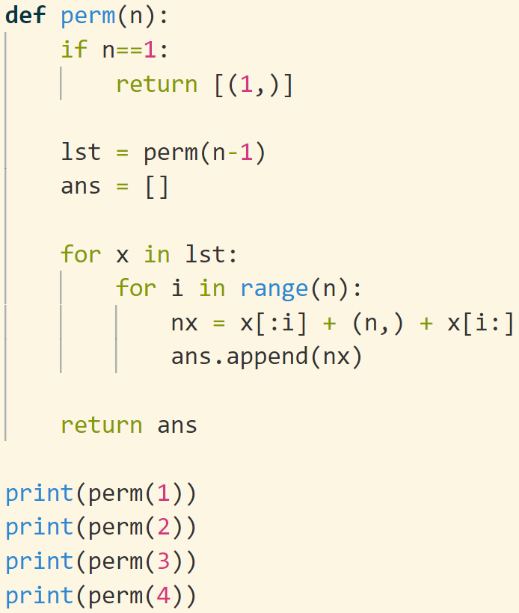
permutation
问题：生成1,…,n的所有排列
问题具有递归的特点：1-n可以由1-(n-1)插入n得到
函数定义 def perm(n): # return list： 每个元素是1-n的一个排列 [[],[],[],…]
扩展问题
有序排列
n选r排列
n选r组合

Slide 26
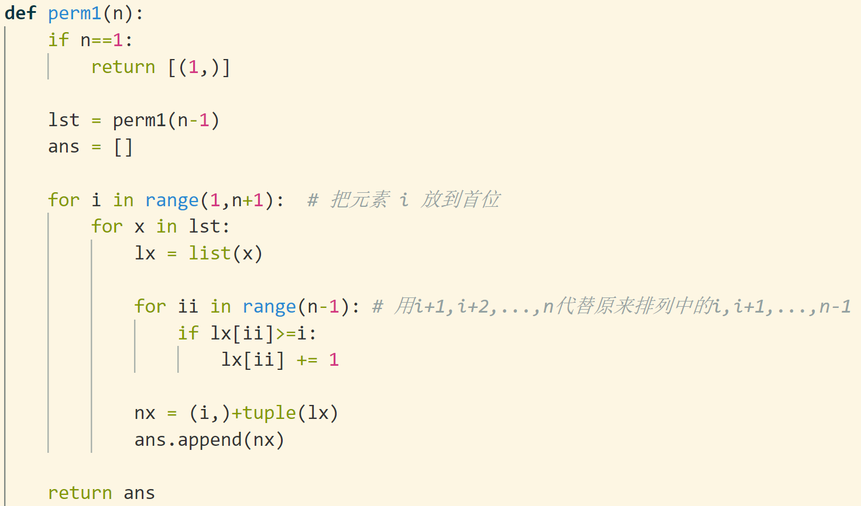
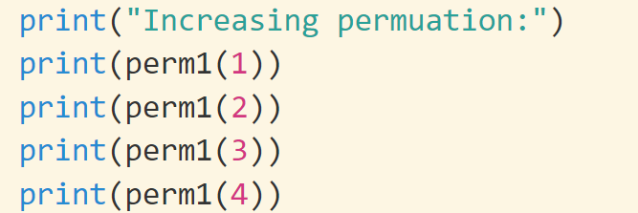

Slide 27
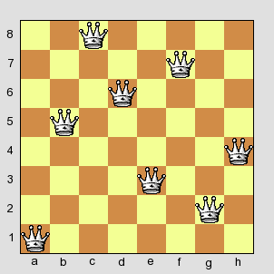
Eight Queens
Find the number of solutions for 8 Queens problem
How to check whether a given solution is valid
How to generate all the possible solutions
Ans: 92
How to represent a solution?
思路：用列表f表示放在各行的皇后的列号，那么f必须是1,…,8的一个排列。枚举1-8的所有排列，判断各个排列是不是合法的皇后放置方式(不同行、不同列，不同对角线)

Slide 28
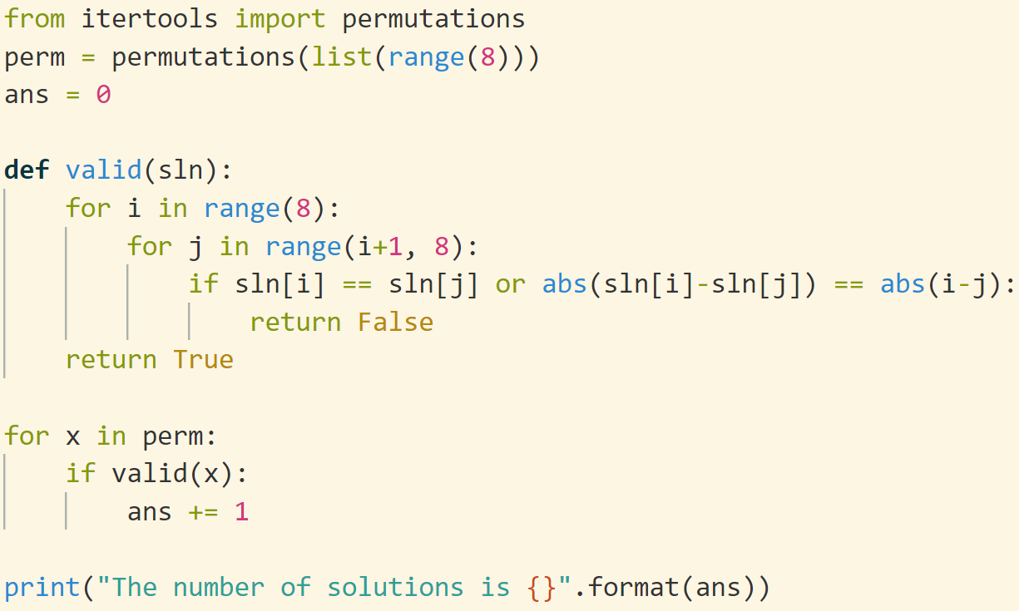
Python中自带了permutation函数，可以生成各种排列组合。
本问题中，和前面的perm函数等价
#等价于Perm=perm(8)

Slide 29
递归与循环
递归：从一般到特殊；循环：从特殊到一般
递归调用其实是个循环过程
递归函数调用需要额外时间、空间开销：传递参数，保存中间值，切换函数
循环比函数递归更高效
递归函数更容易写，更符合人的思维模式
递归函数是把复杂问题转化为简单问题
初学者滥用递归：能用递归的地方一律递归
循环是从简单条件出发一步步构造复杂情况
Life is short, use python: Python给大家很多便利，更符合人的思维
计算机的思维：0/1
你只能用“三角形盖房子”
程序员来适应计算机
任何程序都可以用赋值、逻辑语句、判断语句、循环语句、跳转语句实现
难点：循环语句
while是一个复杂过程
如何通过设计一个循环来完成一个复杂的功能

Slide 30
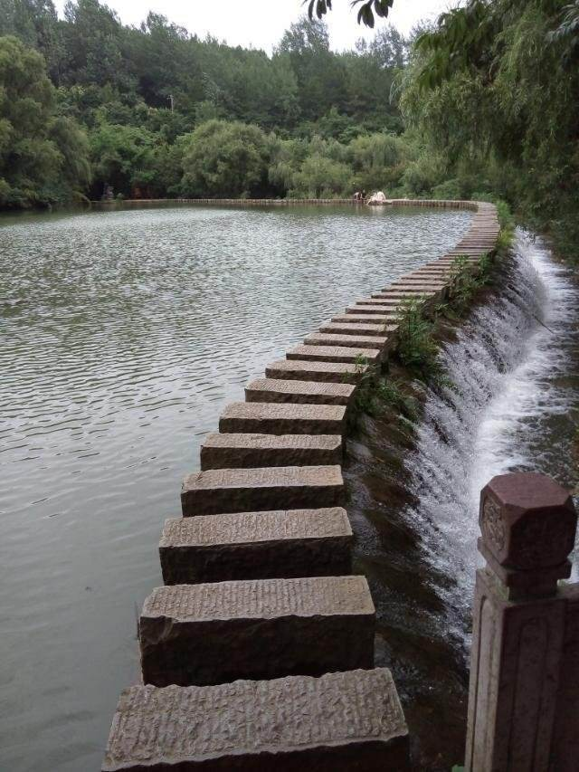
while: 状态更新
判断状态条件
进行操作
修改状态

Slide 31
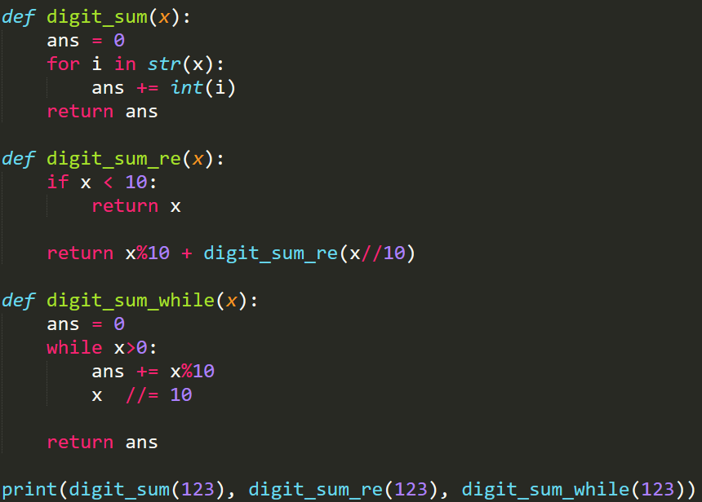

判断状态条件
进行操作
修改状态
递归与循环
计算一个数各位数字的和
while: 必须明确地想清楚整个变化过程, 从i到i+1(递归函数自动完成)
并不是所有的递归都可以很轻松地用while写

Slide 32
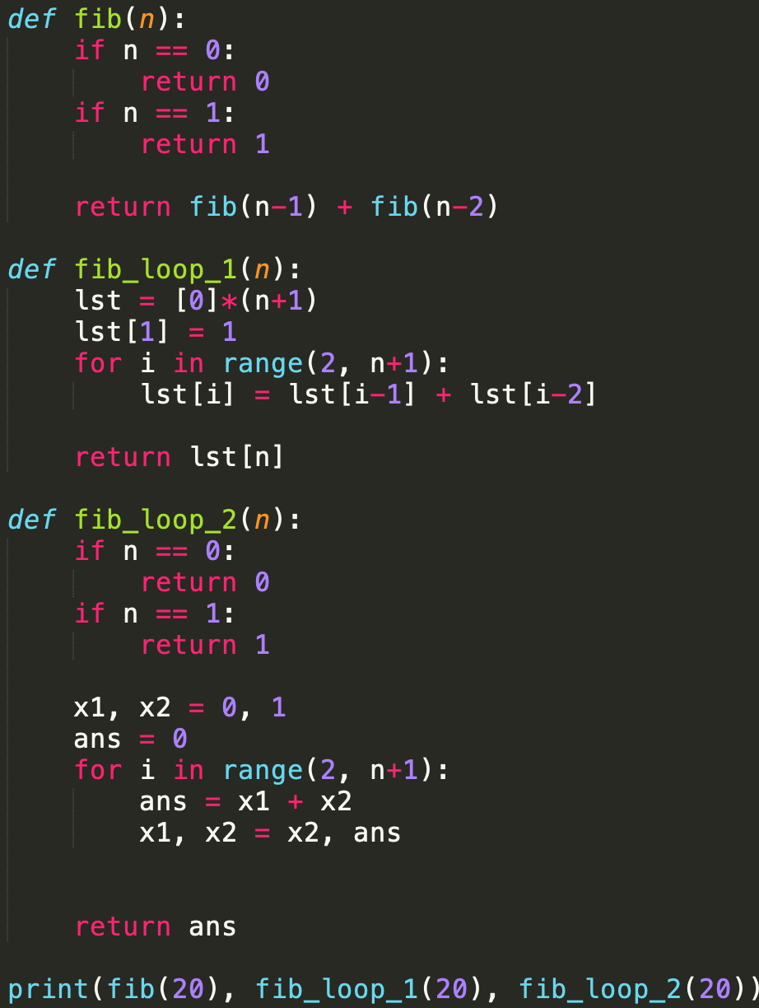

递归与循环
判断状态条件
进行操作
修改状态
计算Fibonacci序列第n项
while: 必须明确地想清楚整个变化过程, 从i到i+1(递归函数自动完成)
并不是所有的递归都可以很轻松地用while写

Slide 33
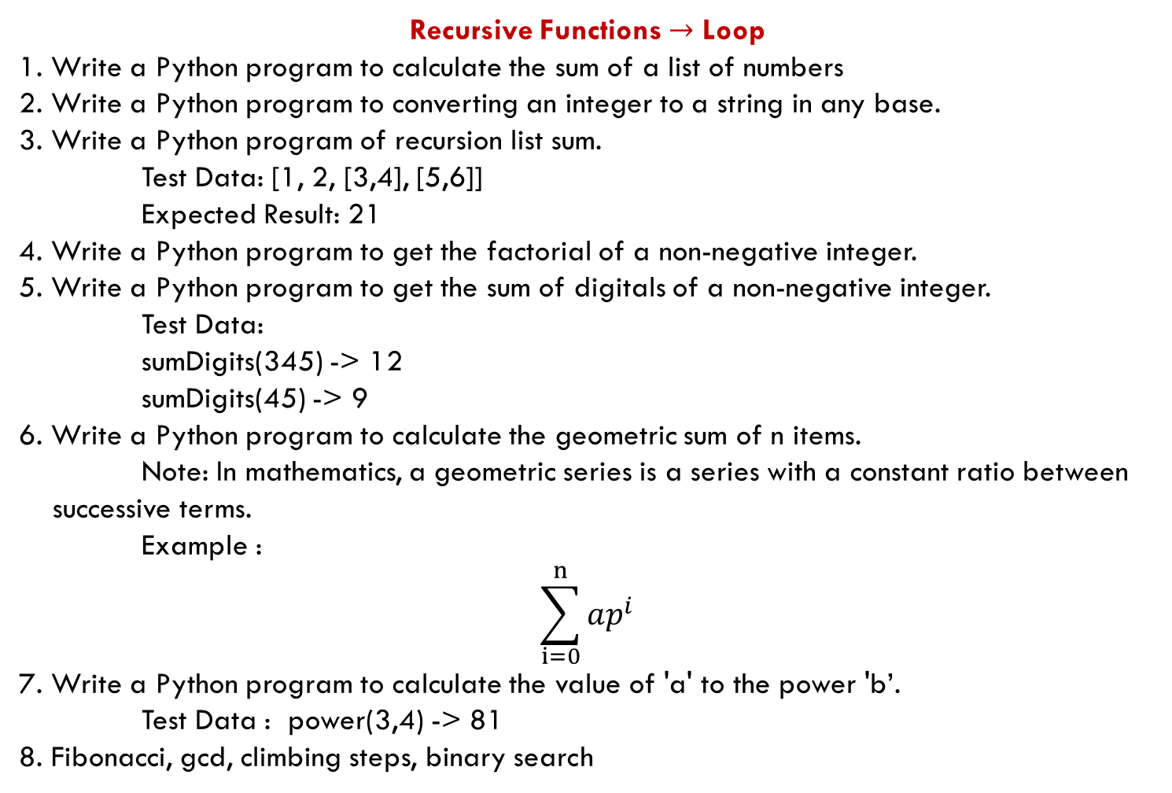
Recursive Functions $→$ Loop
1. Write a Python program to calculate the sum of a list of numbers
2. Write a Python program to converting an integer to a string in any base.
3. Write a Python program of recursion list sum.
Test Data: [1, 2, [3,4], [5,6]]
Expected Result: 21
4. Write a Python program to get the factorial of a non-negative integer.
5. Write a Python program to get the sum of digitals of a non-negative integer.
Test Data:
sumDigits(345) -> 12
sumDigits(45) -> 9
6. Write a Python program to calculate the geometric sum of n items. Note: In mathematics, a geometric series is a series with a constant ratio between
successive terms. Example :
$$\sum_{i=0}^{n}{ap^{i}}$$
7. Write a Python program to calculate the value of 'a' to the power 'b’.
Test Data : power(3,4) -> 81
8. Fibonacci, gcd, climbing steps, binary search
有部分语法暂时超纲

